Slide 1
TALKING WITHOUT TALKING
PRESENTED BY
Managari Shivani
17891A0435
ECE-A
SILENT SOUND TECHNOLOGY

Slide 2


INTRODUCTION
Amazing solution for those who had lost their voice but wish to speak over phone.
Developed at the Karlsruhe Institute of Technology, Germany.
Detects every lip movement and Internally converts the electrical pulses into sounds signals and sends them neglecting all other surrounding noise.

Slide 3

NEED FOR SILENT SOUND
An end to embarrassed situations such as:
A person answering his silent, but vibrating cell phone in a meeting, lecture or performance, and whispering loudly, “ I can’t talk to you right now” .
In the case of an urgent call, apologetically rushing out of the room in order to answer or call the person back.
.

Slide 4
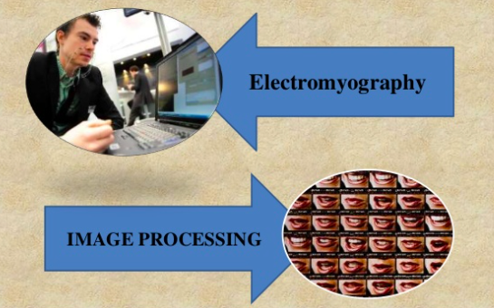
METHODS
.

Slide 5
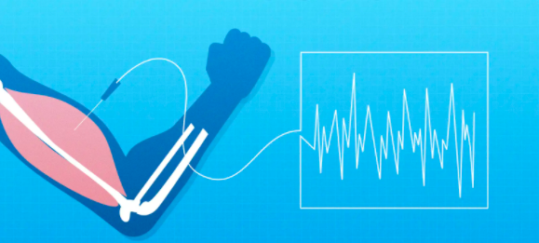
ELECTROMYOGRAPHY
A technique for evaluating and recording the electrical activity produced by skeletal muscles.
It detects the electrical potential generated by muscle cells, when these cells are electrically or neurologically activated.
Performed using instruments called electromyograph, to produce a record called an electromyogram

Slide 6
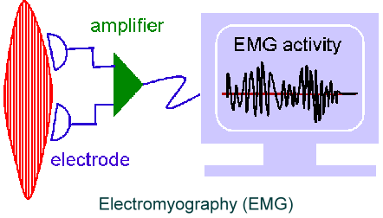
ELECTROMYOGRAPHY SIGNAL GENERATION
Monitor tiny muscular movements that occur when we speak.
Monitored signals are converted into electrical pulses that can then be turned into speech, without a sound uttered.

Slide 7
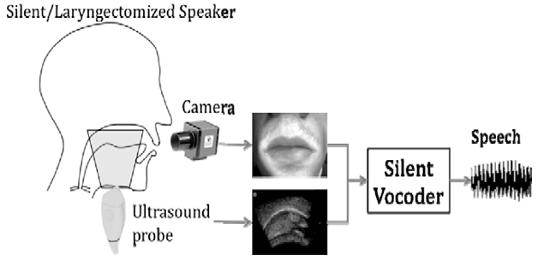
IMAGE PROCESSING
Another way to obtain direct information on the vocal tract configuration is via imaging techniques.
Ultrasound imagery is a non-invasive and clinically safe procedure which makes possible the real-time visualization
An ultrasound transducer, placed beneath the chin, can provide a partial view of the tongue surface.

Slide 8
TYPES OF IMAGE PROCESSING
Analog image processing
Digital image processing

Slide 9
ANALOG IMAGE PROCESSING
Analog processing techniques is applied to hard copy data such as photographs or printouts.
It adopts certain elements of interpretation, such as primary element, spatial arrangement etc.,
With the combination of multi-concept of examining remotely sensed data in multispectral, multitemporal, multiscale and in conjunction with multidisciplinary, allows us to make a verdict not only as to what an object is but also its importance.

Slide 10
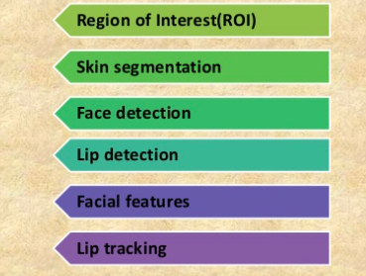
DIGITAL IMAGE PROCESSING
Steps for digital processing are:

Slide 11
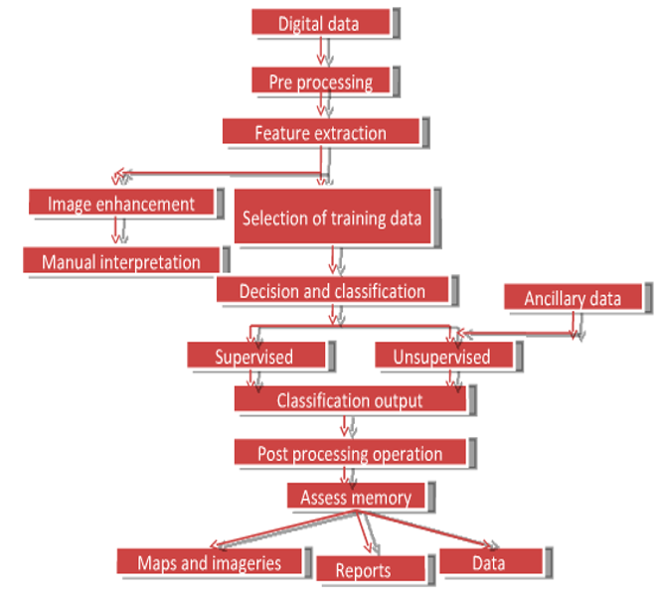
FLOW CHART

Slide 12
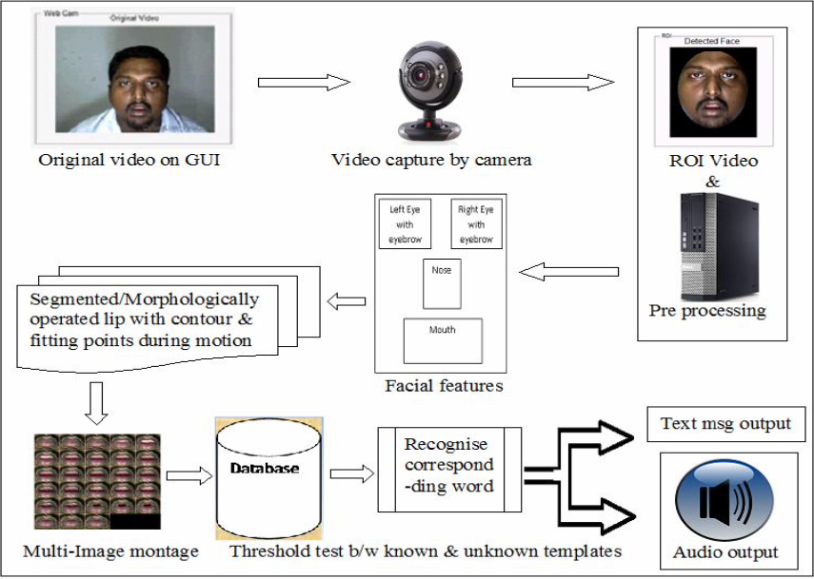

Slide 13
ADVANTAGES
Helping people who have lost their voice due to illness or accident.
We can make silent calls even if we are standing in crowded place.
Very useful for sharing confidential information like secret PIN number on phone at public place.
This technology helps to transmit information without using vocal cords. Who are suffering from Aphasia (Speaking Disorder).
Allow the peoples to make silent calls without bothering others..
Very good technology for noise cancellation technique.

Slide 14
DISADVANTAGES
Translation into majority of languages but for languages such as Chinese different tone holds different meaning, facial movements being the same. Hence this technology is difficult to apply in such situations.
From security point of view recognizing who you are talking to gets complicated.
Even differentiating between people and emotions cannot be done. This means you will always feel you are talking to a robot.
This device presently needs nine leads to be attached to our face which is quite impractical to make it usable.

Slide 15
Applications
Silent Sound Technology is applied in military for communicating secret confidential matters to others.
As we know in Space there is no media for sound to travel therefore this technology can be best utilized by astronauts.
Helping people who have lost their voice due to illness or accident. Hence this technology can be best utilized by dumb people.

Slide 16
CONCLUSION
Silent Sound Technology, one of the recent trends in the field of information technology implements “Talking Without Talking”.
It will be one of the innovation and useful technology and in mere future this technology will be use in our day to day life.

Slide 17

FUTURE SCOPE
Silent sound technology gives way to a bright future to speech recognition technology from simple voice commands to memorandum dictated over the phone all this is fairly possible in noisy public places.
Without having electrodes hanging all around your face, these electrodes will be incorporated into cell phones.
It may have features like lip reading based on image recognition & processing rather than electromyography.
Nano technology will be a mentionable step towards making the device handy.

Slide 18
THANK YOU

